Slide 1



Gene Expression – Part 2 Big Data Analysis
Associate Prof Jess Mar
Australian Institute for Bioengineering & Nanotechnology Level 4 West
j.mar@uq.edu.au
https://aibn.uq.edu.au/mar
@jessicacmar
SCIE2100/BINF6000 – Semester 1, 2021

Slide 2
Questions Addressed Today (& Last Week)
What are the most common platforms for collecting high-throughput gene expression data?
What are the key steps in analyzing RNA-sequencing and microarray data?
How can we learn about biology through analyzing gene expression data?*
*This is a whirlwind tour of some examples. Consider this a starter flight of bioinformatics analyses to pique your curiosity!

Slide 3
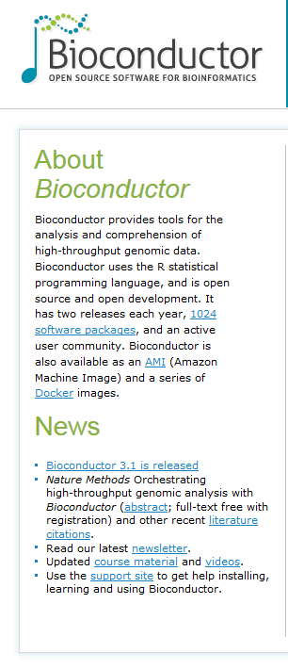
The Bioconductor Project – A Bioinformatics Standard
This project has become the standard repository for R software that deals with all things bio.
A big theme of Bioconductor has been the standardization of data classes to make analysis of –omic data easier, more robust and more reproducible.
The project makes available packages that deal with:
Annotation
Statistical Methods
Pre-processing Approaches
Vignettes will change your life!
http://bioconductor.org

Slide 4
Standard approaches to analyzing large-scale gene expression data begin with identifying what’s different…

Slide 5
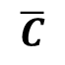
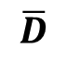
Which Genes Are Different between Two Phenotypes?
Example: the primary goal of the study was to assess differential gene expression in leukocytes between lonely and integrated people.
Difference in Averages
Lonely Group
Integrated Group
$$\overline{D}$$
$$\overline{C}$$
gene expression
What do we know about our patient data?
Where is this information stored?
How can we identify which columns correspond to which patients?

Slide 6
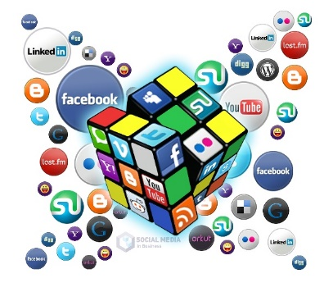
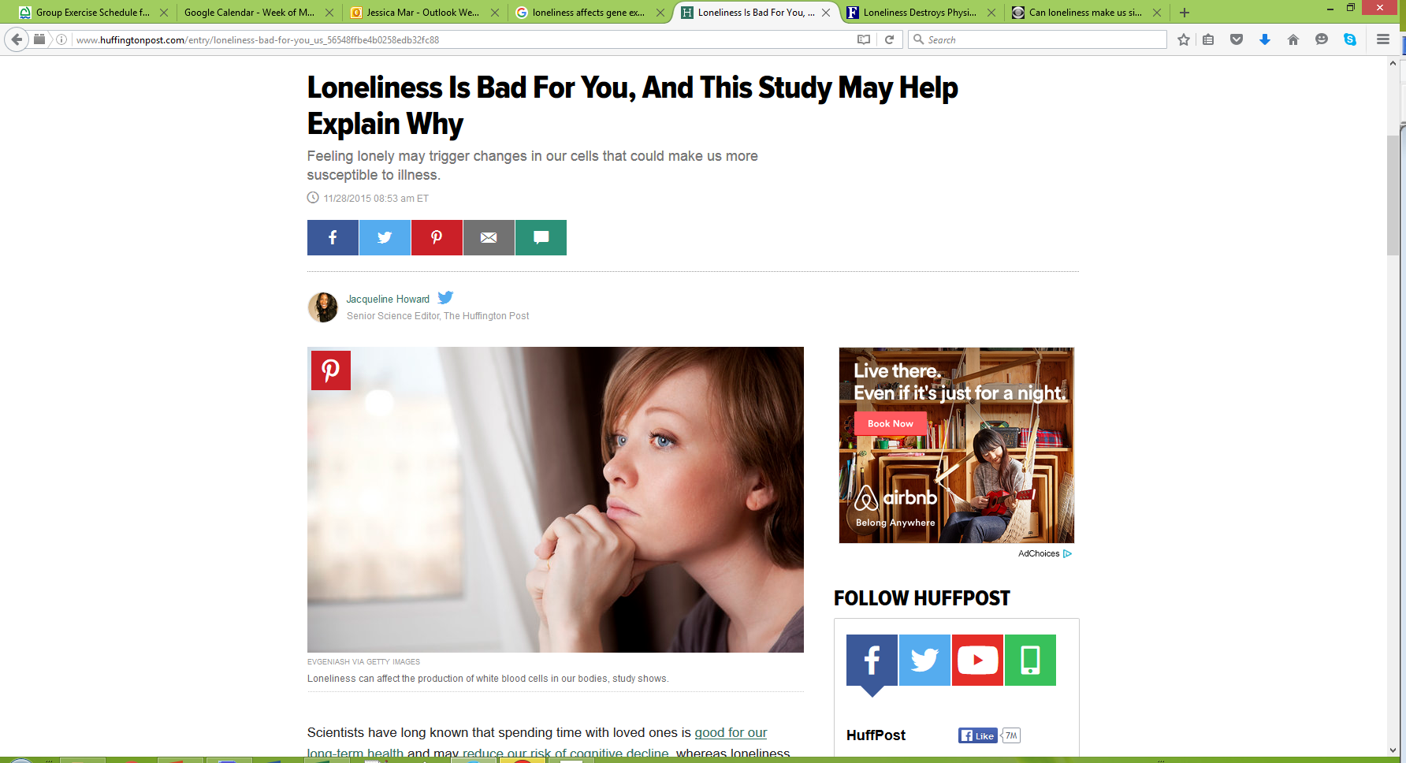
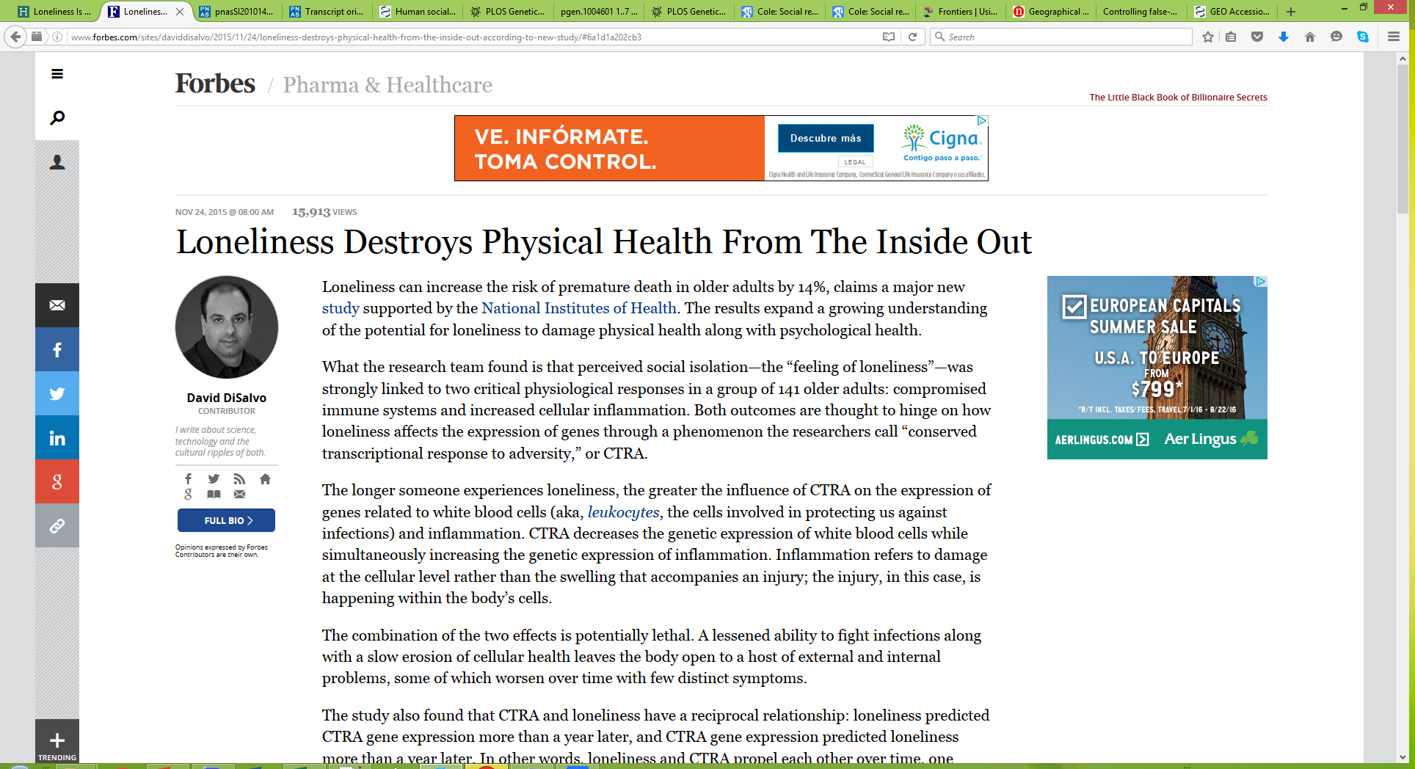

Social Genomics – Loneliness, Happiness and Science?!
An emerging area of social science deals with the intersection of happiness/loneliness and the impact on human health. More recently, this field has taken a quantitative molecular approach, giving rise to “social genomics”.

Slide 7
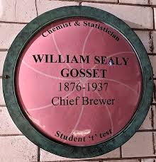
The T-test
$$T_{(gene)}=\frac{\overline{D}−\overline{C}}{f(Var\left(D,C\right))}$$
Which genes have high variance across patients in the same disease group?
How is this distributed through the genome?
Disease Group
Control Group
$$\overline{D}$$
$$\overline{C}$$
Difference in Averages
Historical Note
Gosset worked for the Guiness Brewery in Dublin, Ireland.
He adopted the pseudonym of “Student” because his employer viewed the use of statistics as a trade secret.
Gosset’s job was to apply biochemistry + statistics to an industrial problem.

Slide 8
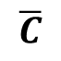
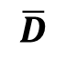
Assessing Differential Expression with a T-test
Difference in Averages
Disease Group
Control Group
$$\overline{D}$$
$$\overline{C}$$
gene expression
Some sample R code:
# for first gene
> t.test(edat[1,lonely.index=="HighLonely"], edat[1,lonely.index=="LowLonely"])

Slide 9
Assessing Differential Expression with a T-test
> runTP <- function(x,y){
res <- t.test(x[y=="HighLonely"], x[y=="LowLonely"])
p <- res$p.value
return(p)
}
> tpvals <- apply(edat, 1, runTP, y=lonely.index)
> length(tpvals)
> sum(tpvals < 0.05)
How many genes are significant after multiple testing correction?
> tapvals <- p.adjust(tpvals, "BH")
> sum(tapvals < 0.05)
> summary(tapvals)

Slide 10
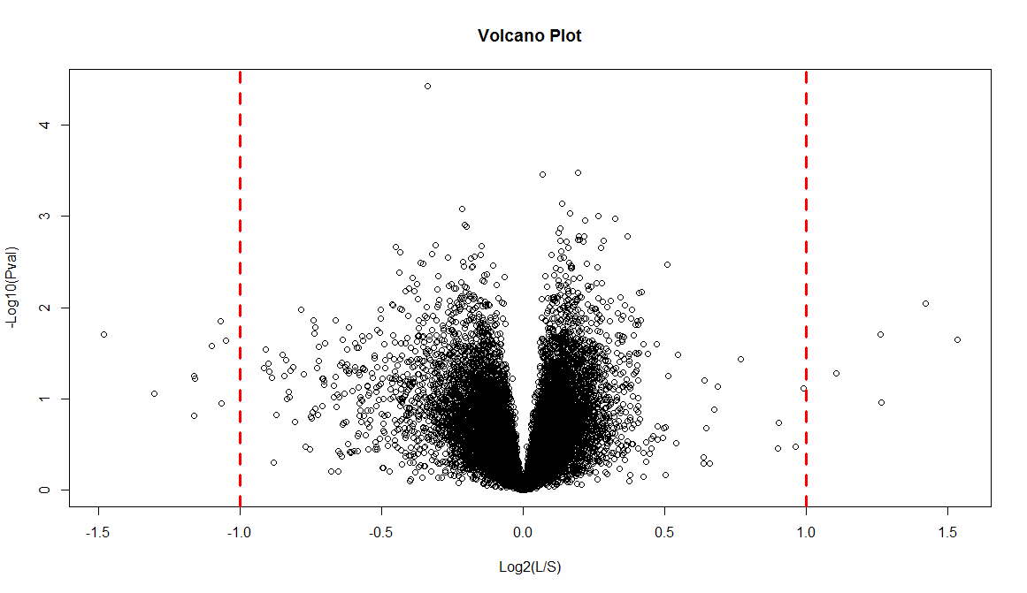
A volcano plot is a device that let’s us assess the overall distribution of differential gene expression
Significance in differential expression
P-value = 0.05
Log₂ Expression Fold Change shows the direction of gene expression in one condition relative to another

Slide 11
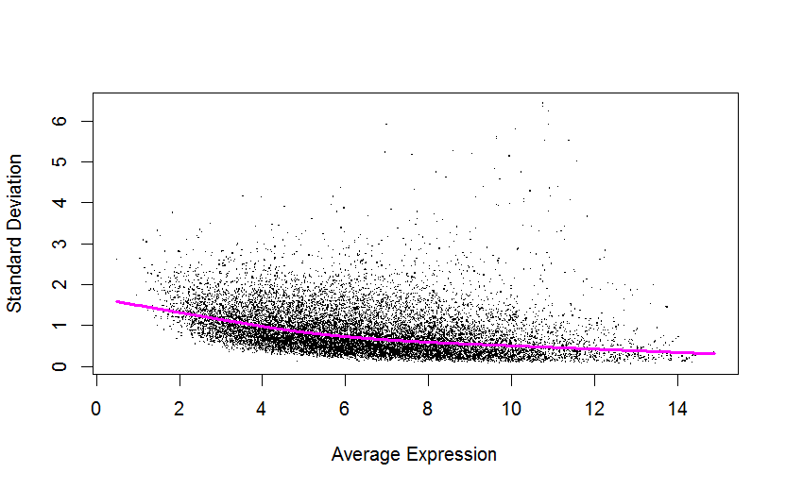
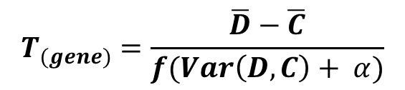
Testing for differential expression using limma*
When dealing with –omic level platforms, we are working with high-dimensional data, and tiny quantities of biological material.
Noisy data and false positives are therefore bound to occur.
Limma uses an empirical Bayes method to estimate differential expression by minimizing the variance estimate.
This results in a moderated T-statistic:
$$T_{(gene)}=\frac{\overline{D}−\overline{C}}{f(Var\left(D,C\right)+ α)}$$
*limma is a R/Bioconductor package that is used for microarray and RNA-seq data analysis.

Slide 12
Integrating gene expression with other types of –omics data

Slide 13
Integrating gene expression data to understand biology
Do we see similar gene expression patterns in the lonely cohorts profiled in PNAS (2011, 2015) and Genome Biology (2007).
Which pathways (pro-inflammatory?) have different expression in lonely versus non-lonely people?
1. Meta-Analysis
Building evidence for consistent trends across multiples lines of data sources and experiments.
2. Integrating with external sources of information.
Interpreting results using pathways, gene sets or other properties of interest from the literature.
3. Integrating different types of genome-wide data.
Modeling related high-throughput data sets to identify multi-level regulatory events.
Are genes with differential expression in the lonely versus non-lonely people associated with SNPs or CNVs?

Slide 14
Pathways and ontologies
Efforts have been made to systematically characterize our knowledge of biological pathways and processes into public databases.
KEGG: Kyoto Encyclopedia of Genes and Genomes
Initially set up to characterize metabolic pathways, but now represents all cellular pathways. Low coverage of the genome, but high quality gene sets.
Reactome
Pathway information is manually curated and peer-reviewed, can be downloaded in different formats and cross referenced to other databases.
Gene Ontology
Hierarchical definitions by biological process (BP), molecular function (MF), cellular component (CC). Genes can be filtered on evidence codes representing the reliability of the assignment.
MSigDB
One of the most comprehensive sources of gene set information; there are 7 major groups, some of which overlap with the above resources.
In R: KEGGREST
In R: reactome.db
In R: GOstats

Slide 15
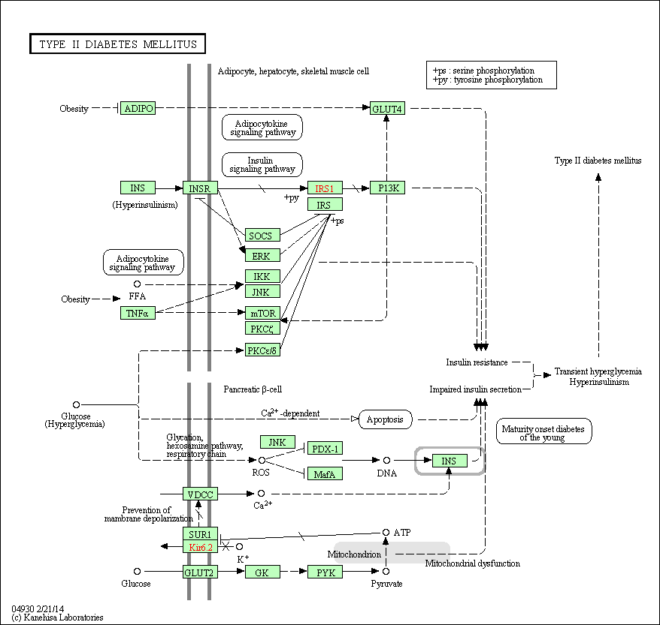

KEGG Pathway: Type II Diabetes (human)

Slide 16
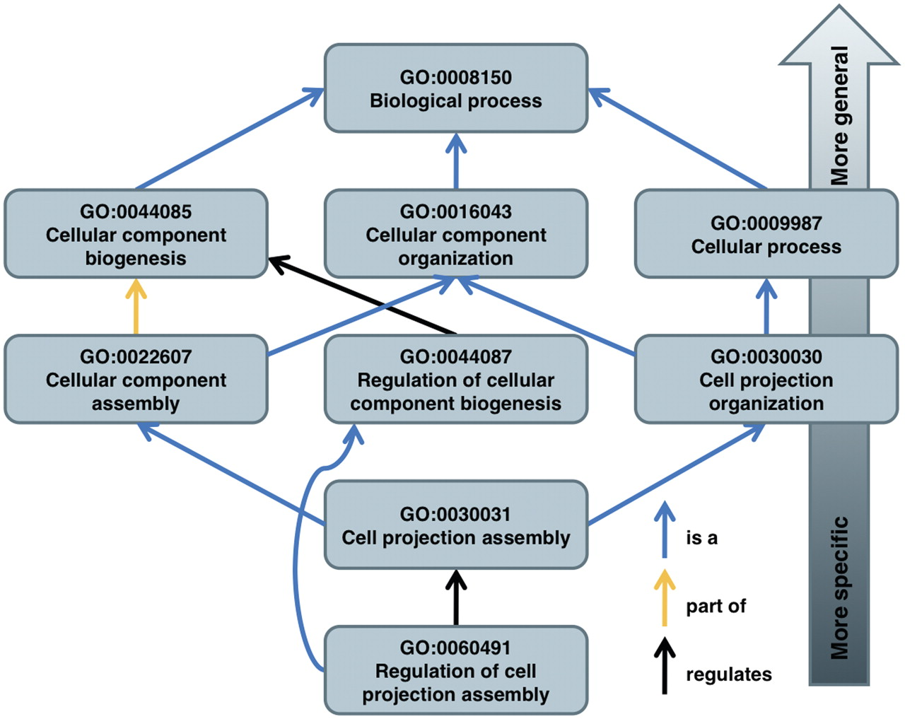

Gene Ontology: a computational representation of biological knowledge
Louis du Plessis et al. Brief Bioinform 2011;12:723-735
© The Author 2011. Published by Oxford University Press.
Notes:
The structure of the GO is illustrated on some of the paths of term GO:0060491 to its root term. Note that it is possible for a term to have multiple parents.

Slide 17
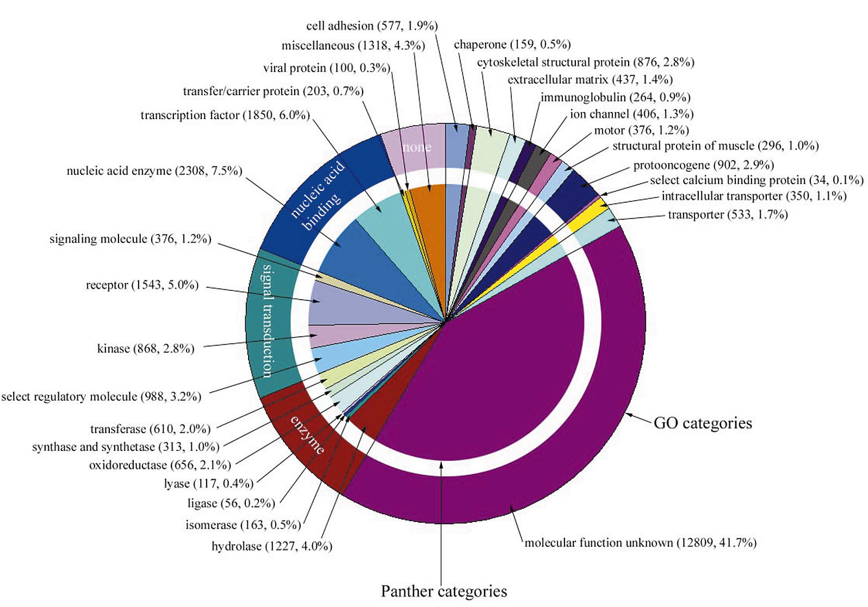
Distribution of Human Genes in GO:MF (20 years ago!)
Vintage Genomics
#tbt
What does this distribution look like now?
Venter et al. (2001). Science.
The Sequence of the Human Genome.
Notes:
http://www.sciencemag.org/content/291/5507/1304.full.pdf

Slide 18
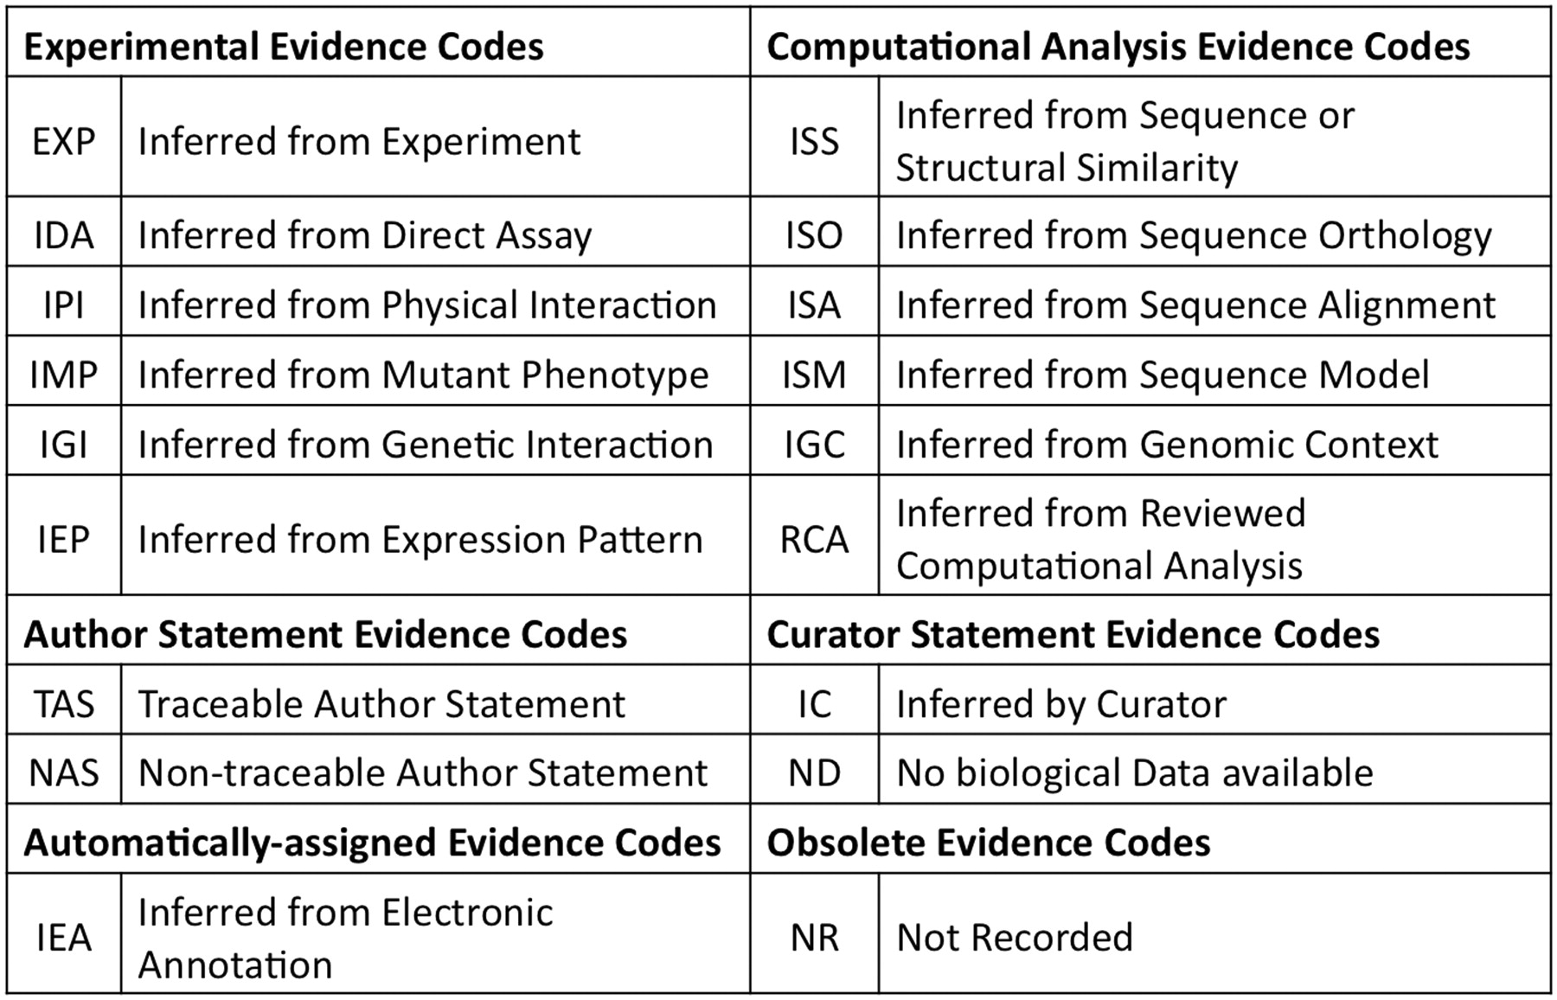
Where does the information come from?
GO evidence codes and their abbreviations.
du Plessis et al. (2011). Briefings in Bioinformatics. 12:723-735
© The Author 2011. Published by Oxford University Press.
Notes:
GO evidence codes and their abbreviations. Evidence code NR (not recorded) is used for annotations assigned prior to the use of evidence codes, and is not assigned to new annotations.

Slide 19
Integrating gene lists of interest with pathway information provides biological/mechanistic context
ZFPM1 NLGN2
EXOC6 GLIPR2
COX4I1 PLXDC2
ECH1 MGP
ZMAT3 BTF3L4
ECM2 OR11L1
PORCN EGFLAM
IL13RA1 NELFB
RPPH1 NR2F2
SCRN1 TMSB15B
TRAK1 SNAPC4
HBEGF DKK3
WDR12 STX2
RFX1 HSPA1A
What do these genes do?
Is there a significant over-representation of a certain pathway or important gene set?

Slide 20
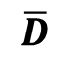
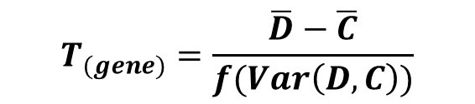
Over-representation analysis: Fisher’s Exact Test
Tests the association between two variables using a Hypergeometric distribution.
Fisher’s Exact Test tests the enrichment of seeing an overlap between two variables.
It can also be used to test the goodness of fit exactly.
Used for small numbers, but actually works for any size.
VARIABLE A
YES
NO
NO
x
y
S_{Z}
VARIABLE B
YES
j
k
S_{X}
S_{Y}
$$P\left(X=x\right)=\frac{\left(\begin{matrix}S_{X} \\ x\end{matrix}\right)\left(\begin{matrix}S_{Y} \\ y\end{matrix}\right)}{\left(\begin{matrix}S_{X}+S_{Y} \\ S_{Z}\end{matrix}\right)}=\frac{\left(\begin{matrix}S_{X} \\ x\end{matrix}\right)\left(\begin{matrix}S_{Y} \\ y\end{matrix}\right)}{\left(\begin{matrix}S_{X}+S_{Y} \\ x+y\end{matrix}\right)}$$
for
$$\max\left(0,S_{Z}−y\right)≤x≤min⁡(S_{Z},S_{X})$$

Slide 21
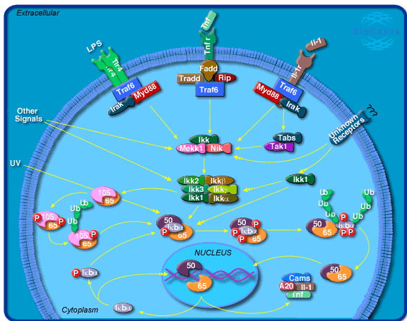
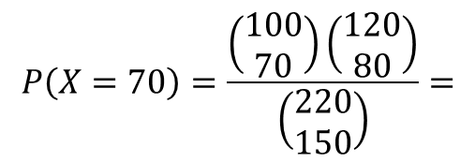
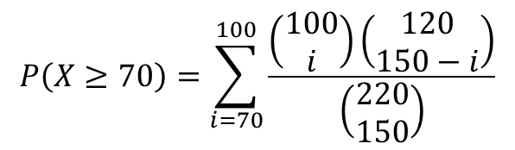
Testing for enrichment of a single pathway in a given gene list
Consider a list of genes (e.g. loneliness study/cancer biomarker/your dream experiment). The goal is to examine whether this list is enriched for genes in the NFκB pathway.
NFκB Pathway (BioCarta)
Interesting Gene List
Not in Interesting Gene List
Genes in NFκB Pathway
70
y
150
Genes Not in NFκB Pathway
j
k
2 x 2 contingency table
100
120
Hypergeometric random variable
$$P\left(X=70\right)=\frac{\left(\begin{matrix}100 \\ 70\end{matrix}\right)\left(\begin{aligned}120 \\ 80\end{aligned}\right)}{\left(\begin{matrix}220 \\ 150\end{matrix}\right)}=$$
probability of seeing 70 genes that belong to the NFκB pathway AND in biomarker gene list.
$$P\left(X≥70\right)=\sum_{i=70}^{100}{\frac{\left(\begin{matrix}100 \\ i\end{matrix}\right)\left(\begin{aligned}120 \\ 150−i\end{aligned}\right)}{\left(\begin{matrix}220 \\ 150\end{matrix}\right)}}$$
P-value =

Slide 22
Applying Fisher’s Exact Test in R
NFκB Pathway (BioCarta)
Interesting Gene List
Not in Interesting Gene List
Genes in Pathway Z
70
y
150
j
k
Genes Not in Pathway Z
100
120
> tab <- cbind(c(70, 100-70), c(80,40))
> fish.res <- fisher.test(tab, alt="great")
> fish.res$p.value # P-value

Slide 23
Identifying groups of genes based on clusters of expression profiles

Slide 24
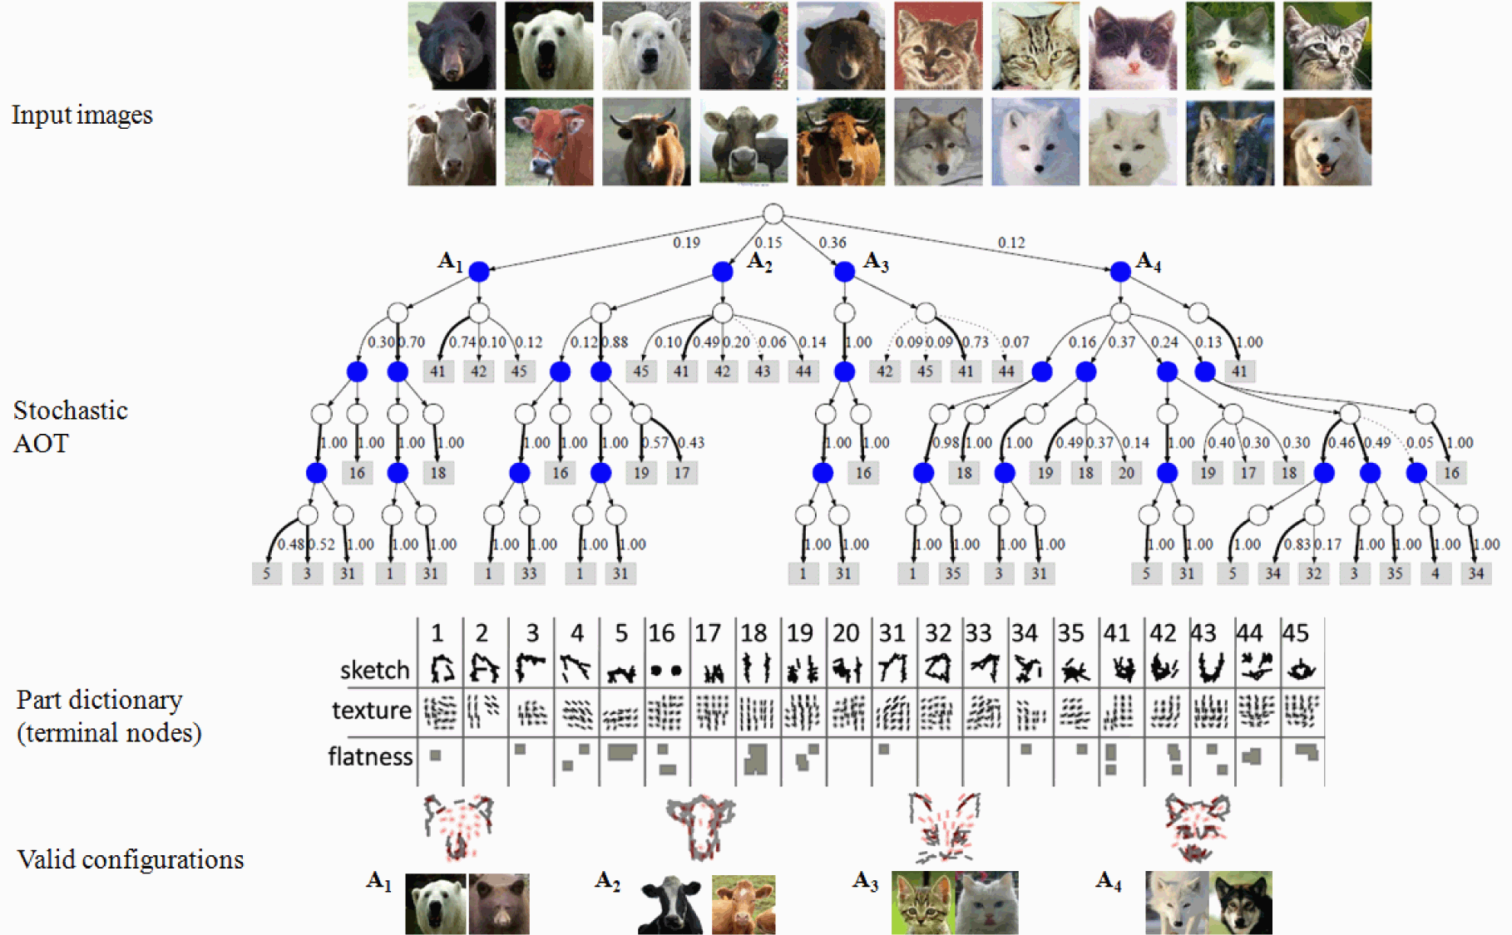
Unsupervised learning is the task of identifying patterns in the presence of many data variables where the number of patterns is also not known.
Si & Zhu. (2013). IEEE Transactions on Pattern Analysis & Machine Intelligence

Slide 25
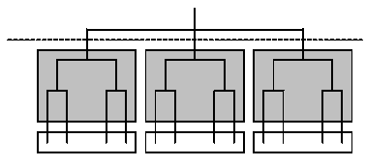
Hierarchical clustering
Constructs a hierarchy of clusters.
Nodes in the dendrogram can be either genes, or samples or both (bi-clustering).
n genes in n clusters
agglomerative
divisive
n genes in 1 cluster
dendrogram
We join nodes based on the notion of maximum ‘similarity’.
Equivalently, we break nodes based on minimal similarity
Source: J-Express Manual
Notes:
Biodist

Slide 26
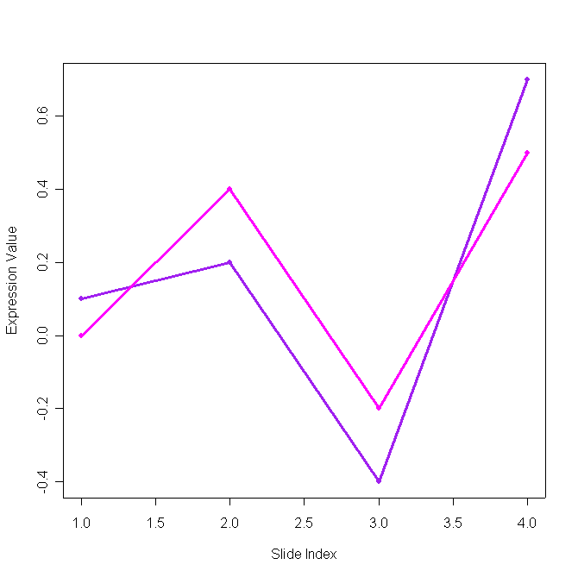
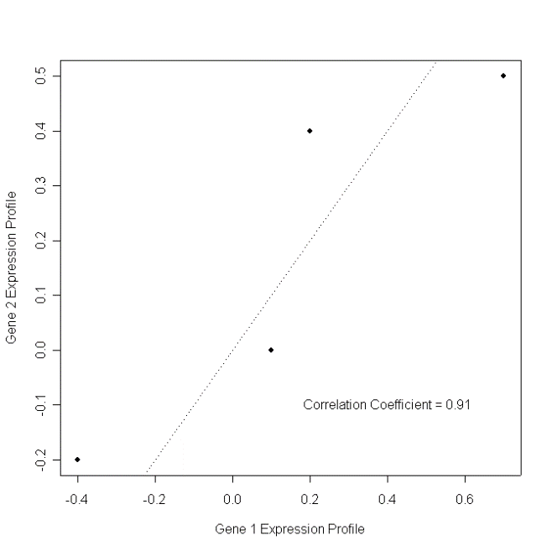
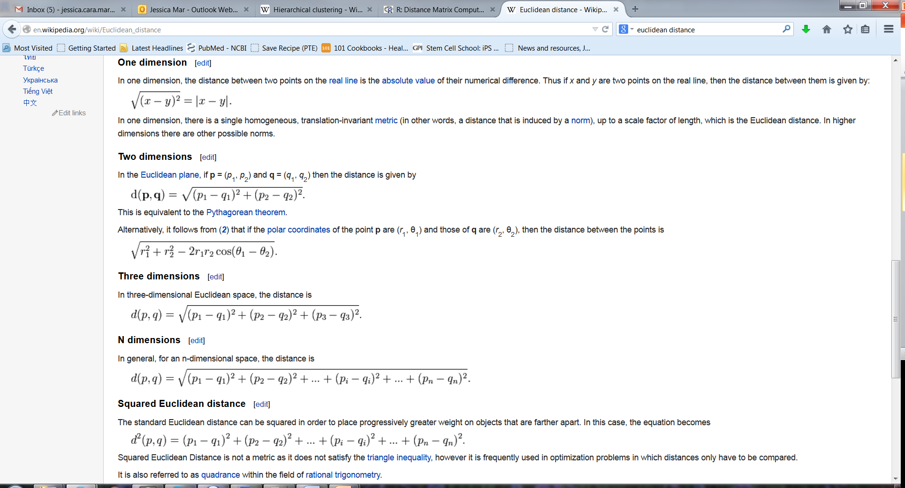
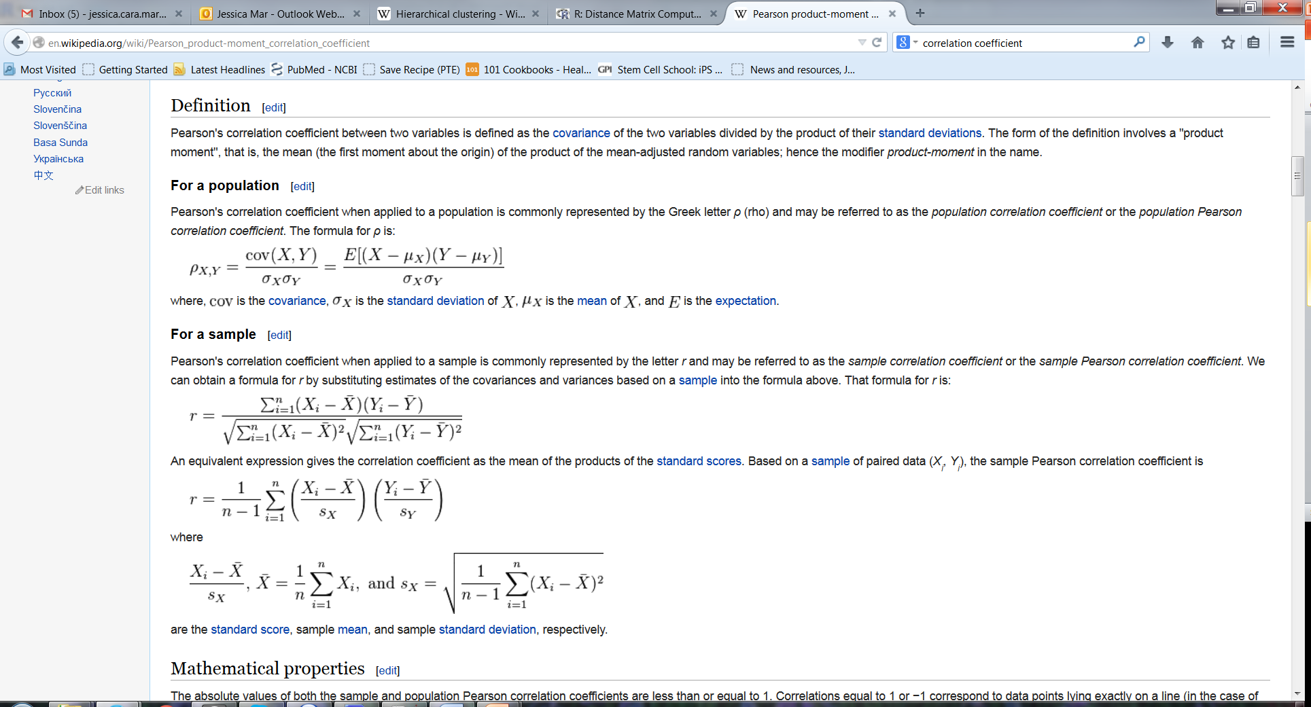
Measures of similarity – what counts as the same versus different?
Consider expression profiles of Gene X and Gene Y: how do we score their similarity?
Euclidean Distance
Correlation Coefficient
Expression Profile
Gene Y
Samples
Gene X
Notes:
Biodist

Slide 27
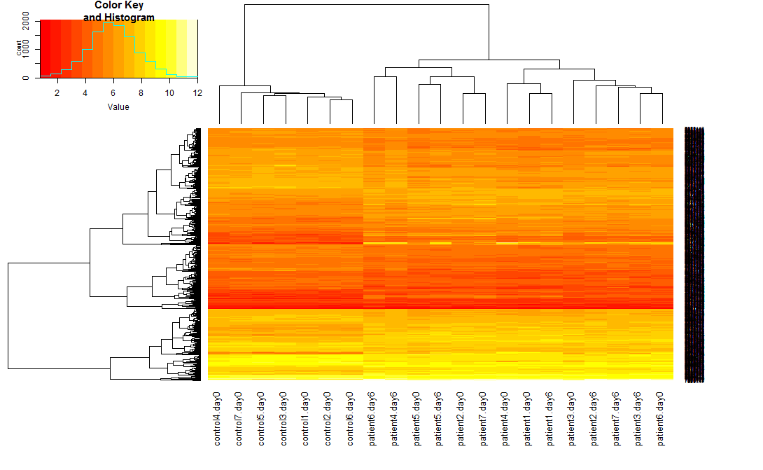
Heatmaps!
> source("http://www.bioconductor.org/biocLite.R")
> biocLite("gplots")
> library(gplots)
> heatmap.2(edat.sig, trace="none", margins=c(8,8))
More information via this helpful tutorial.

Slide 28
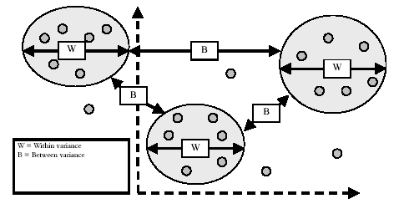
Partitioning methods: k-means clustering
Identifying the distinct set of expression profiles represented in the data set.
Grouping genes based on their similarity to cluster profile.
W – within variance
B – between variance
Reference: J-Express manual

Slide 29
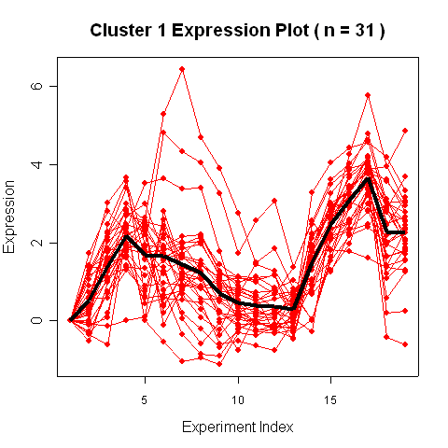
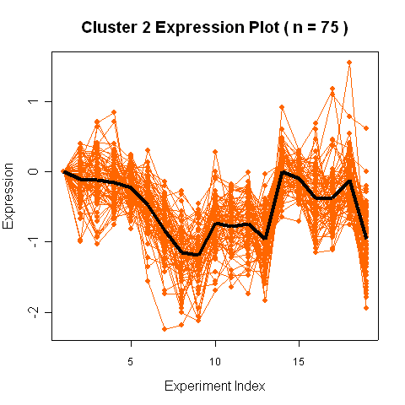
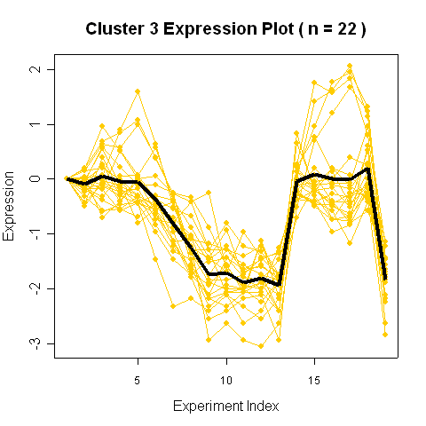
General Framework of a K-means Algorithm
Step 0: Start with a defined number of clusters.
Step 1: Initialize clusters; usually based on agglomerative hierarchical clusters.
Means = K-means.
Medians = K-medoids, PAM
Step 2: Random sort of list, assign each gene to a cluster based on distance metric.
Step 3: Assess convergence criteria. If convergence achieved, stop. Otherwise repeat.

Slide 30
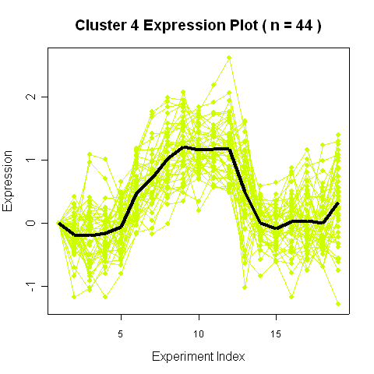
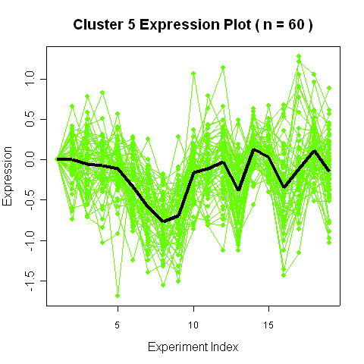
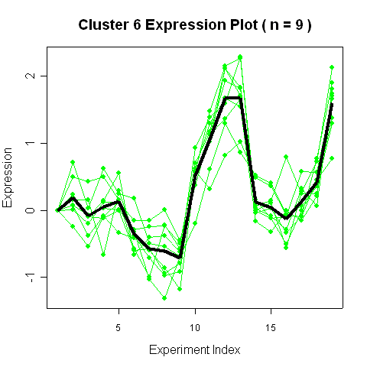
Mapping Genes to their Roles in the Cell Cycle
241 Saccharomyces Cerevisiae genes from a time course experiment into 6 clusters.
Spellman et al. (1998). Mol Bio Cell. Comprehensive identification of cell cycle-regulated genes of the yeast Saccharomyces cerevisiae by microarray hybridization.
Notes:
.

Slide 31
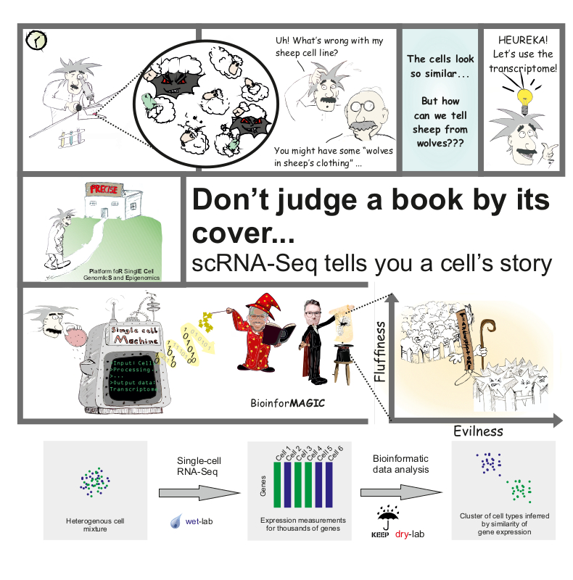
Applications for the Future: single cell RNA-sequencing!
http://www.immunosensation-blog.de/dont-judge-book-cover-scrna-seq-tells-cells-story/

Slide 32
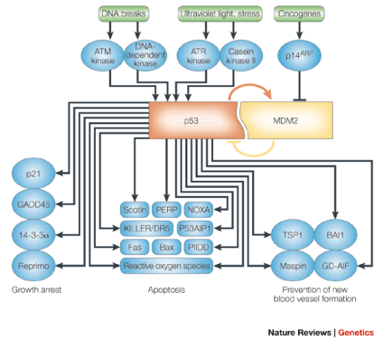
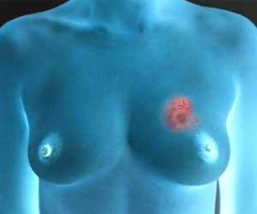
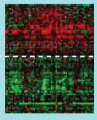
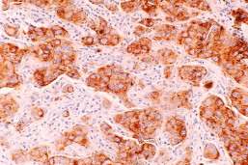
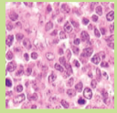
Breast Cancer: a disease-related example
Biology occurs on many different scales
Behavior/aberration of gene profiles:
Oncotype DX, MammaPrint.
Single cell features:
Histopathology & Grade
Multi-cellular organization
Behavior/physiology of cells:
Staging – TNM classification; 0 to 4
Sub-cellular molecules (genes, proteins)
Tissues
Cells
T = size of tumor
N = spread to lymph nodes?
M = metastasized?
Genome-wide
Microarrays & Sequencing
Notes:
Maybe helpful: http://www.cancer.gov/cancertopics/understandingcancer/genomewideprofiling/page12

Slide 33
Cell populations are inherently heterogeneous
Ensemble methods survey the "average" transcriptome: microarrays, qPCR, RNA-seq
Single cell sequencing is changing the way in we think about transcriptional regulation.
Notes:
The question is whether the observations are equally effecting all members, or reflecting diversification of the population itself.

Slide 34
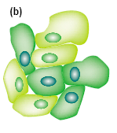
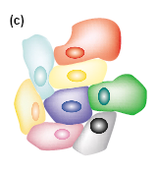
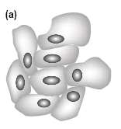
Conceptualizing gene expression in single cells
1980s:
Before single cell assays were invented:
Single-cell gene expression profiling in 2001.
In situ hybridization in 1989 gave snapshots of individual nuclei.
Cells express genes heterogeneously around a distribution of levels.
Cells were thought to be identical.
Genes are either “on” or “off”.
Levsky and Singer. (2003). Gene expression and the myth of the average cell. Trends in Cell Biology.

Slide 35
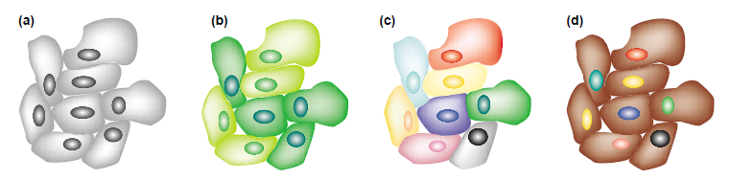
Understanding the functional effects of variability is the next frontier
How are cells able to tolerate gene expression variability and maintain similar physiological function?
Are fluctuations dampened out at the protein level, over time, via different network configurations?

Slide 36
Global patterns of transcriptional regulation of cell type diversity are within reach!
Analysis of 44,80 cells via Drop-seq identified 39 cell populations in the mouse retina.
Macosko et al. (2015). Cell. Highly parallel genome-wide expression profiling of individual cells using nanoliter droplets.

Slide 37
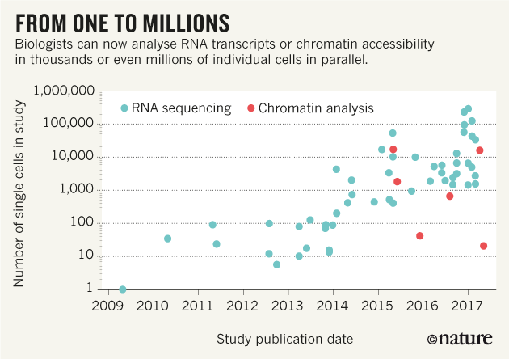
Single cell RNA-seq throughput has exploded!
The Human Cell Atlas: from vision to reality : Nature News & Comment. 26 Oct 2017. Vol 550.

Slide 38
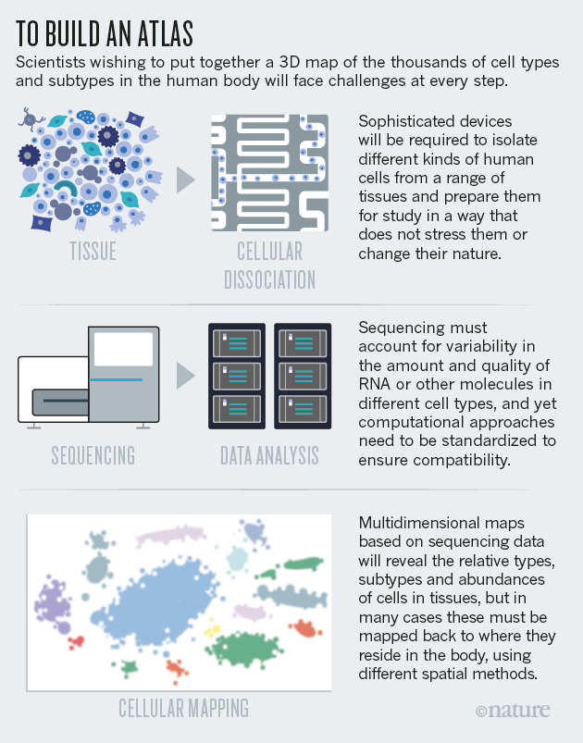
The Human Cell Atlas is currently the latest big data international consortium for RNA-sequencing.
https://www.humancellatlas.org/
The goal is to create a reference map for all human cells in the body – at single cell resolution.
This creates new challenges in technology, data analysis, and storage.
This is a great example of advances of next-generation sequencing are giving us new ways to do (exquisite) cell biology!
http://www.nature.com/news/how-to-build-a-human-cell-atlas-1.22239

Slide 39
Lecture Summary
RNA-sequencing and microarrays are generally used for high-throughput gene expression data, with the former looking to eclipse the latter.
Pre-processing of RNA-seq data requires alignment of reads, transcript identification and quantification.
Different statistical approaches can be used to identify changes and patterns in expression data.
Bioinformatic tools based ontologies and pathways can be used to identify biological themes in the data.
There is no MAGIC in bioinformatics methods! (Only straightforward math and programming code).

Slide 40
For any questions, clarification or inspiring ideas please get in touch via email!
Research internships, Hons & Masters projects,
PhD applications available with my lab.
Jess Mar, PhD
Australian Institute for Bioengineering & Nanotechnology Level 4 West
jmar@uq.edu.au
https://aibn.uq.edu.au/mar

